Slide 1
Module 10 Schema Conversion
Lesson 3: Conversion problems
Notes:
Welcome to Lesson 3 of Module 10 on Schema Conversion
- Convert from ERD to table design
- First step in logical database design
- Conversion practice on exercise problems
Opening question: subtle question about conversion
How are optional FKs derived from an ERD?
How are optional FKs shown in a table design?
What is the most common mistake made when converting an ERD to a table design? Misplaced FK

Slide 2
Lesson Objectives
Practice on moderate size ERDs
Gain insight about notation differences
Notes:
Objectives:
- Apply conversion rules to transform ERD into a table design
- Understand the differences between the ERD notation and relational data model
- Master conversion with lots of practice

Slide 3
University Database ERD
Notes:
Demonstrates most of the notation previously shown
- 1-M relationships: Has, Teaches, Supervises, Registers, Grants
- Optional relationships: Teaches, Supervises
- Mandatory relationship: Has, Registers, Grants
- Self referencing relationship: Supervises
- Weak entity (also associative entity type): Enrollment
- Identifying relationships: Registers, Grants
- Could apply relationship equivalence to transform Enrollment, Registers, and Grants into a M-N relationship with an attribute

Slide 4
Conversion Rule Application
Entity type rule
Course
Student
Enrollment
Faculty
Offering
1-M relationship rule
Enrollment.StdNo
Enrollment.OfferNo
Offering.CourseNo
Offering.FacNo (optional)
Faculty.FacSupNo (optional)
M-N relationship rule
No application
Identifying relationship rule
Enrollment.StdNo (PK)
Enrollment.OfferNo (PK)
Notes:
1-M relationship rule
Registers to Enrollment.StdNo
Grants to Enrollment.OfferNo
Has to Offering.CourseNo
Teaches to Offering.FacNo (optional)
Supervises to Faculty.FacSupNo (optional)
Registers to Enrollment.StdNo as part of Enrollment PK
Grants to Enrollment.OfferNo as part of Enrollment PK

Slide 5
University Database Table Design
CREATE TABLE Course (…, PRIMARY KEY (CourseNo) )
CREATE TABLE Student(…, PRIMARY KEY (StdNo) )
CREATE TABLE Faculty(…, PRIMARY KEY (FacNo), FOREIGN KEY (FacSupNo) REFERENCES Faculty )
CREATE TABLE Offering (…, PRIMARY KEY (OfferNo), FOREIGN KEY (CourseNo) REFERENCES Course, FOREIGN KEY (FacNo) REFERENCES Faculty, CONSTRAINT CourseNo NOT NULL )
CREATE TABLE Enrollment (…, PRIMARY KEY (OfferNo, StdNo), FOREIGN KEY (OfferNo) REFERENCES Offering, FOREIGN KEY (StdNo) REFERENCES Student )
Notes:
Only PK and FKs shown
Entity type rule: 5 applications (5 tables)
1-M relationship rule: 5 applications (5 FKs)
M-N relationship rule: no applications
Identifying relationship rule: 2 applications (add StdNo OfferNo as components of the PK of Enrollment)
Additional issues
- Required constraints

Slide 6
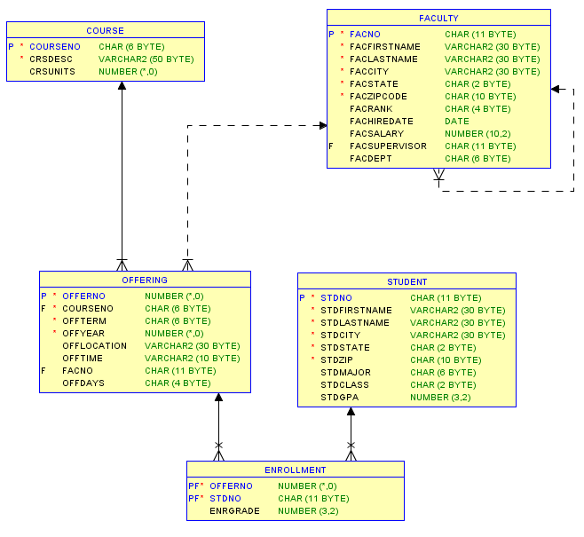
University Database Relational Diagram
Notes:
Oracle Relational Diagram
Created in Oracle SQL Developer
Select New Design in Data Modeler -> Browser
Drag tables into design window
View Details: shows columns and data types in this diagram
Can also show other details such as restricting to keys only (not other columns)
Notation
Solid line: mandatory relationship (NOT NULL constraint for FK)
Dashed line: optional relationship (NULL values allowed)
Cross: FK is part of PK

Slide 7
Practice Conversion Problem
Notes:
Similar to University DB conversion
Invideo questions: only provide partial solutions in invideo quiz
M-N relationship rule: which relationship used
No Id dependency rule: is it used
Entity type rule: 4 tables
1-M relationship rule:
3 FKs (Order.CustNo, Order.EmpNo, EmpNo.SupNo (for Manages)
Optional FKs: Order.EmpNo, Employee.SupNo
M-N relationship rule
Contains table: can rename using a noun
Combine PK: OrdNo, ProdNo
FKs: OrdNo, ProdNo
Qty column

Slide 8
Summary
Apply rules on practice and graded problems
Knowledge of conversion rules clarifies notation differences
Notes:
Some other rules for generalization hierarchies
Design tools have close association between ERD and table design. The ERD notation often shows FKs.

Slide 9
Common Conversion Error
Incorrect application of 1-M relationship rule
CREATE TABLE Faculty(…, PRIMARY KEY (FacNo), FOREIGN KEY (OfferNo) REFERENCES Offering, … )
Correct application of 1-M relationship rule
CREATE TABLE Offering (…, PRIMARY KEY (OfferNo), FOREIGN KEY (FacNo) REFERENCES Faculty, … )
Notes:
Conversion of 1-M relationship between Faculty and Offering
Common error: Faculty.OfferNo FK instead of Offering.FacNo FK

